Slide 1


Slide 2
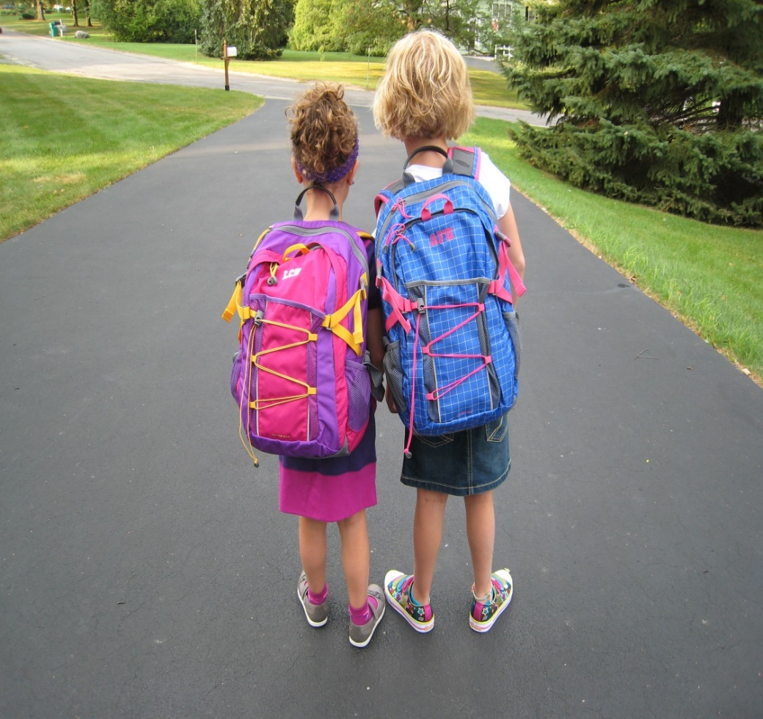
Starting School

Slide 3
Welcome!!
Welcome to a new and exciting stage in your child’s life.
During this year, your child will make new friends and enjoy a variety of new experiences.
We understand that with Covid 19 the circumstances are a little strange but we will do our best to help your child feel comfortable in our school.

Slide 4


School Hours
School begins at 8.40am normally, but as explained during Covid starting times need to be staggered to ensure safety.
Group 1 - Surnames beginning A - E: 8.40 – 8:50
Group 2 – Surnames beginning F - K: 8:50 - 9:00
Group 3 – Surnames beginning L - P: 9:00 - 9:10
Group 4 - Surnames beginning Q - Z: 9:10 - 9:20
A teacher is on duty each morning to open the gate.
Children come straight into their classroom.

Slide 5
Collecting your child
Ms. Wallace's class go home at 1:25 pm.
No parent/guardian/child minder should come down to collect their child from Ms.Wallace’s class until my class and the person collecting them has left the school grounds. This is very important. Parents need to stand away from the gate area in Pery Square and social distance until the Senior Infants and First Class have left.
To introduce each Junior Infant smoothly into their new school environment, Junior Infant pupils will go home at 11.50am for the first two weeks until – until Fri 11th September.
Children to be collected at the pedestrian gate by a parent or designated person. * Acceptance Form

Slide 6
Breaks
There are two breaks during the day.
The first is from 10.00 to 10.20am. After which we will have our snack food time.
The second is from 11.40 to 12.00. After this we will have our lunch food time.
An area of the playground is reserved especially for Ms Wallace’s class

Slide 7
Clothes
We do not have a uniform in Saint Michael’s National School. However the children should wear comfortable clothing daily.
Runners are needed as the children play outdoors daily. VELCRO footwear is essential for all pupils who have not yet learned how to tie laces. This is especially important this school year with social distancing, so we ask all parents to choose correct footwear for their child.

Slide 8
First day – a happy one!
Please help prepare your child for their new school environment.
On Monday 31st August you and your child will meet the teacher and visit the classroom
On this day we will encourage you to practice with your child how they will walk in alone from the main door

Slide 9
First day – a happy one!
On your child’s first day parents cannot come into the building but if you are worried you can wait in the shelter shed in the yard.
We will phone you if your child is upset.
For 1 week you can say goodbye from the pedestrian gate at the end of the ramp

Slide 10
Week 2 – Monday 7th September
On week two we ask that parents do not enter the school grounds at all. Encourage your child to walk down. Prepare them for this in advance.
There are 3 staff on duty and once your child is on the grounds the only way out is via the gate they came in.

Slide 11
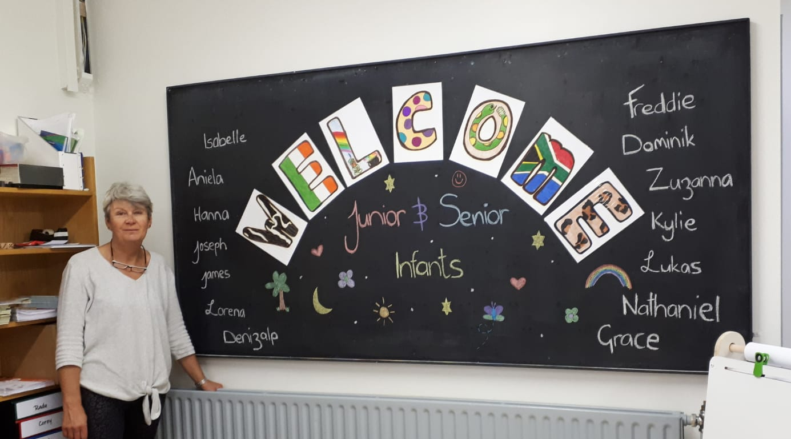
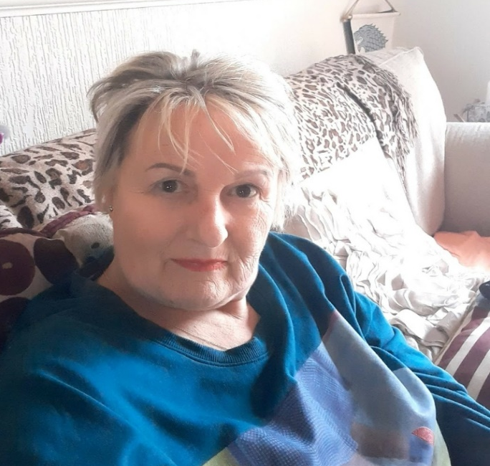
Who will work with your child
Ms.Wallace
Ms Wallace is your child’s class teacher
Ms Hayes is a Special Needs
assistant – she will be working
in your child’s classroom
Ms Hayes

Slide 12
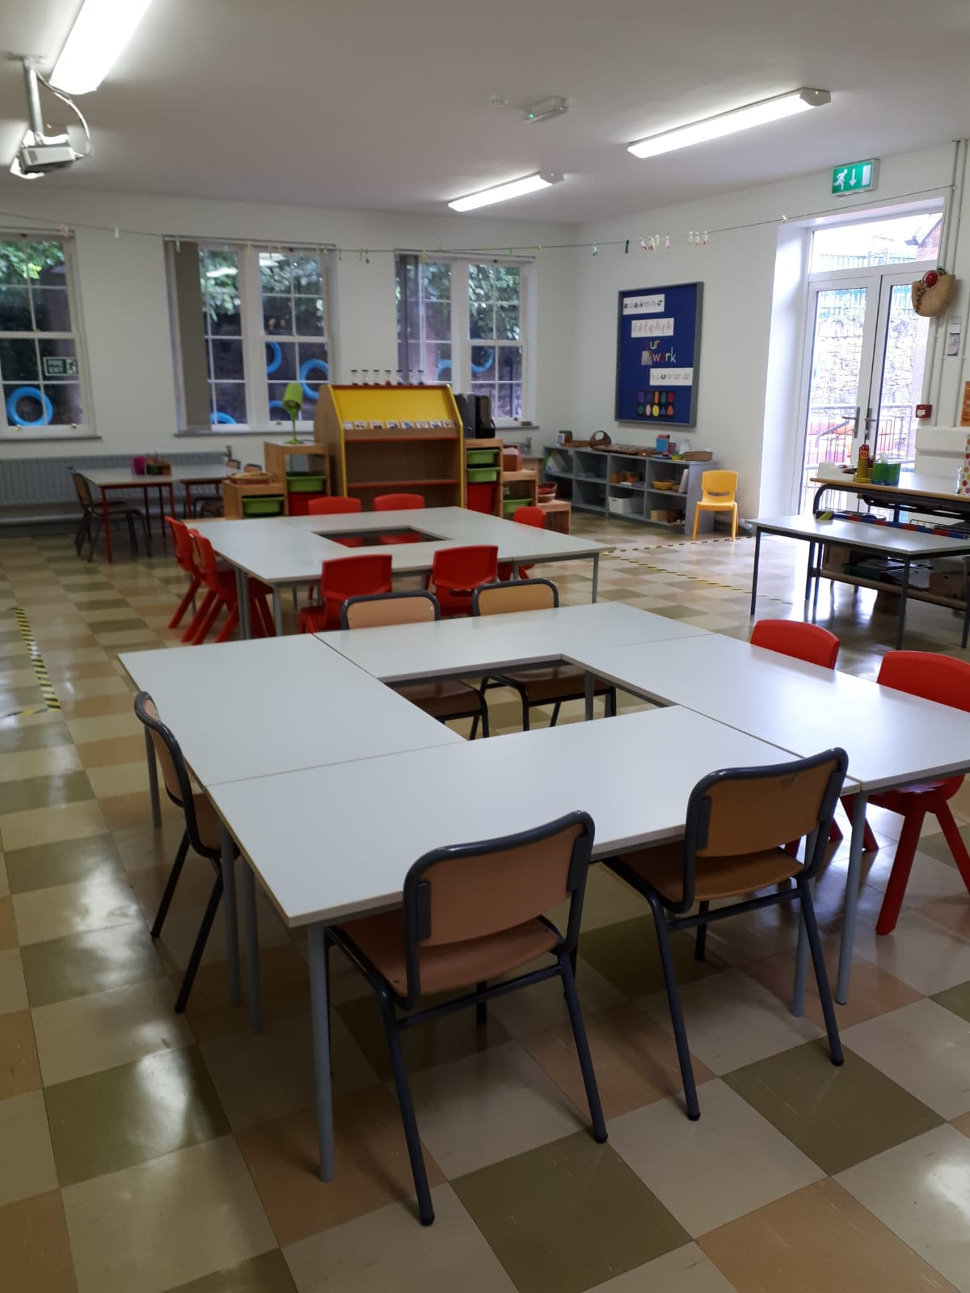
Junior/Senior Infant Classroom

Slide 13
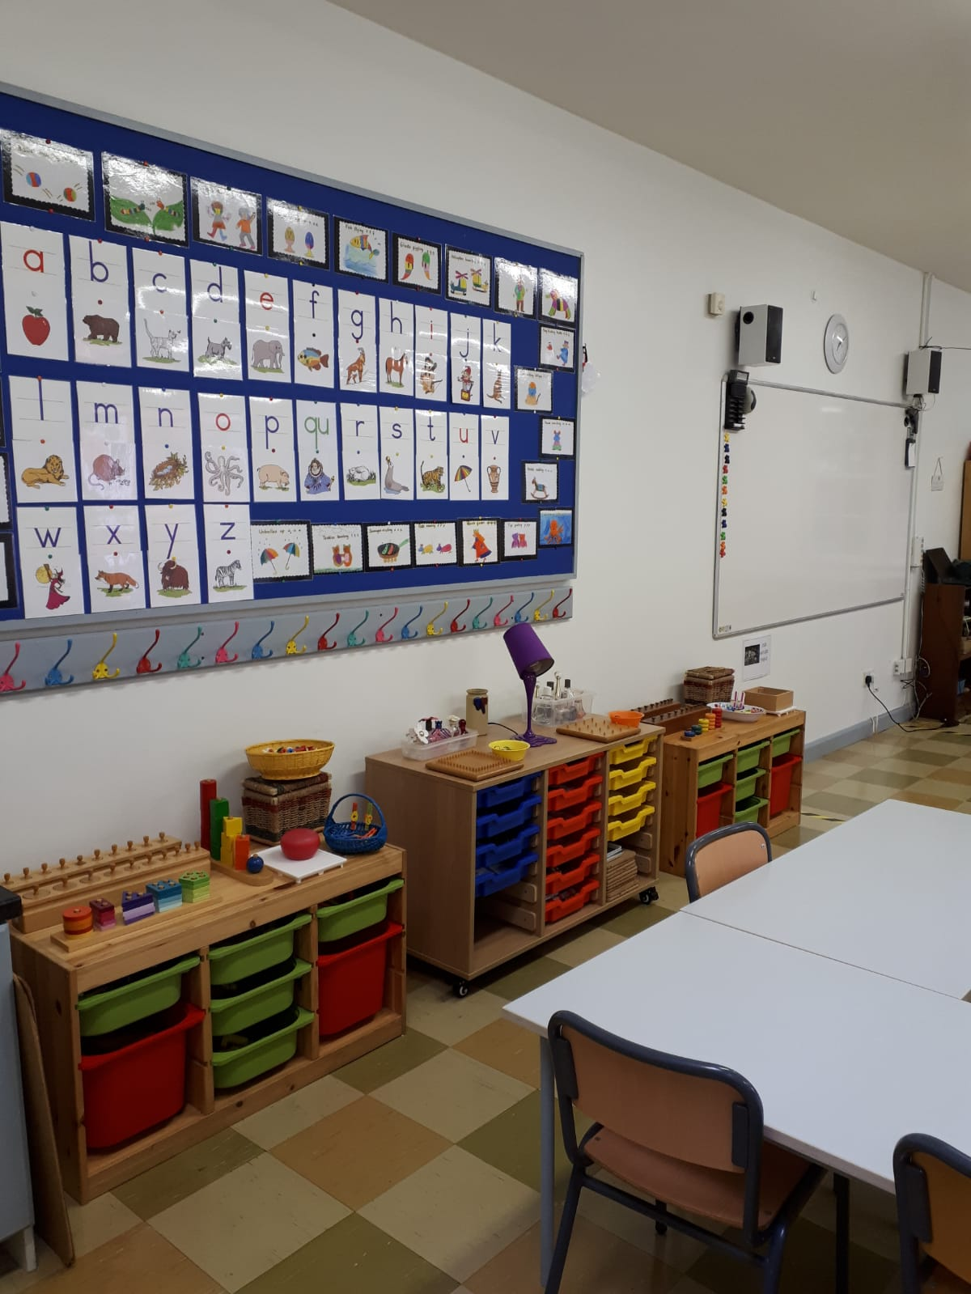
Junior/Senior Infant Classroom

Slide 14

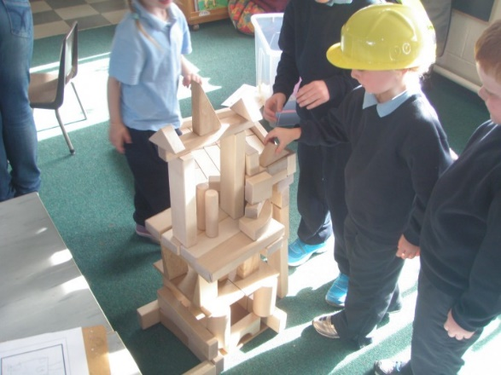
Play
Play is a significant part of your child’s development in school and is carried out on a daily basis. There are many types of play which attribute to holistic development during the early childhood years: language play, physical play, pretend play, creative play and games with rules.
Play helps your child to
Build relationships: learn to share, take turns, problem solve…
Be creative
Read, write and learn about numbers
Think
Use language
Use fine and gross motor skills

Slide 15

Toys
There is no need for children to bring toys into school and we do not encourage this practice because of breakages, competition and peer pressure.
We have plenty of toys in school.

Slide 16


Beginning to read…
This is the scheme used for learning letters, their sounds and learning to read.
Emphasis is on letter “sounds” NOT the names of the letters.

Slide 17
Reading
We use a combination of two approaches:
“Little Books” which the child takes home and reads with the help of an adult.
High Frequency sight words
Two types of words:
Can sound them out (cat, big…)
Tricky words (was, they…)

Slide 18
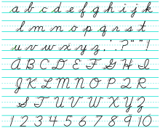
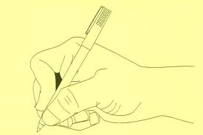
Writing
Your child will be learning to do cursive writing. This will commence formally in January.
Pencil Grip

Slide 19

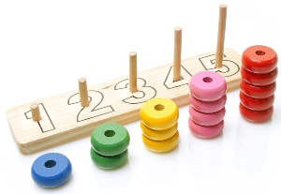
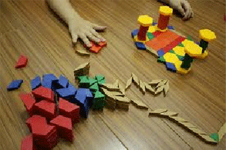
Other Subjects
Maths-very concrete and hands on.
Irish-speaking and listening.
History, Geography, Science
Music, Drama, Art
SPHE
RE
PE

Slide 20
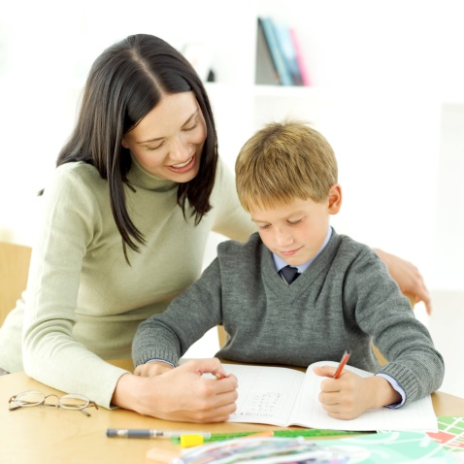
Homework
Starts after the Mid-Term break in October.
They love it..so tap in to this short lived phenomena and make it an enjoyable activity !

Slide 21
Food
Please choose a lunch box and a drink bottle that can be easily opened by your child.
As part of our Social, Personal and Health Education Programme we have a Healthy Eating Policy. We encourage children to bring a healthy lunch to school. Nourishing foods are encouraged.
We ask you not to include crisps, sweets, fizzy drinks or any junk food in your child’s lunchbox.
As we are a “Green School”, we ask that all children have a reusable lunchbox and that they bring drinks in a reusable bottle.
We ask that little or no food is in plastic covering. Ideally, each piece of food should be edible straight from the lunch box.

Slide 22
Stationery
Pencils, crayons, rubbers etc. are provided for your child in school.
They will of course need writing and colouring materials for home use.
Your book bill contribution will cover the cost of all reading books used by your child.
Please cover and label all books with the name of your child clearly written on the outside front cover.

Slide 23

School Bag
Please ensure that the school bag is big enough to hold an A4 size folder and will also allow for your child’s coat to be folded up and kept in the bag during class time.
This year we are not using coat hooks like we usually do, so coats will need to be stored in schoolbags.

Slide 24

Birthday Invitations
Birthday invitations are strictly forbidden in our school
Teachers cannot give out invitations and neither can children
Parents should hand out invites OFF school grounds if they wish to have a party for their child.

Slide 25
Health and Safety
Occasionally your permission will be required for vaccinations or health examinations.
In primary school head lice may be an issue. When and if so, you will be informed about an incident of it and asked to check your child’s hair carefully.

Slide 26
Communication
Please do not hesitate in messaging me if you have a concern
Seesaw Family App – this app allows you to message me directly if you have any messages you want to give me or small concerns.
If I need to discuss something, I can
call you by phone or arrange a
Zoom call

Slide 27
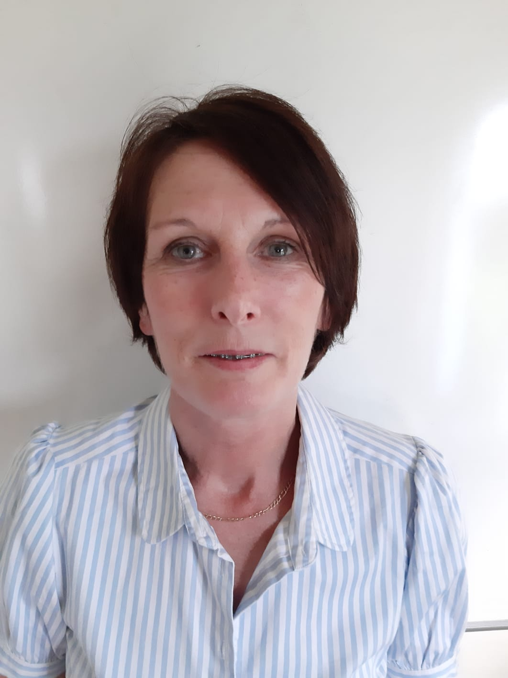
Office
Annette is our school secretary.
Also known as Ms O’Neill
She works everyday except Wednesday.
Office hours are 9am to 2pm.
Telephone 061 315927
Email info@smnslimerick.ie

Slide 28

School Website
www.smnslimerick.ie
If you are looking for something it is a great place to start!

Slide 29
Created by Lesley Cooke
See you in soon!!!

